Slide 1


ECONOMIC IMPACT OF
MARICULTURE PARK
AquaPark – Norad funded project

Slide 2
OUTLINE
Economic implications of MPs
A. For the different types of locators
B. For the Local Government Units
C. For BFAR in terms technical and infrastructure support.
Impacts of MPs on the economy of the municipality
A. Job generation
B. Establishment of infrastructure
C. Trading/Marketing
III. Cost comparisons
A. Local and regional market analysis comparisons.
B. Differences in regional input cost compari
C. Cost/benefit and breakeven analysis for support
infrastructure/technical services

Slide 3
I
WHAT DO WE PLAN TO DO?
IMPLEMENTATION STRATEGY FOR THE
AQUAPARK PROJECT
A. Data collection to attain the objecti
Environmental survey
Economics survey
Socio-economic survey
Site selection/GIS
B. Formulate guidelines in establishing MPC.
Marketing strategies
Recommendations

Slide 4
STRATEGY OF IMPLEMENTATION (TEAM APPROACH)
WHAT DO WE PLAN TO DO?
Economic Group
Socio-economic Group
Each group shall individually pursue the defined objectives assigned
for each as described in the Terms of Reference (TOR).
In this regard, the Economic Group shall pursue the following
objectives:
Overall Objectives
To investigate the economics of mariculture parks for:
ọ - the different types of locators
ọ - the local Government/BFAR MP development,
technical and infrastructure support.

Slide 5
KEY COMPONENTS OF THIS INVESTIGATION
WHAT DO WE PLAN TO DO?
ECONOMIC ASSESSMENT OF THE FOLLOWING:
Different aquacultural farming systems in the MPs;
2. LGU and BFAR support for setting up and providing
support of the MP
3. Differences in regional input cost comparisons,
Cost/benefit and breakeven analysis for support
infrastructure
5. Local and regional market analysis comparisons.

Slide 6
ECONOMIC IMPLICATIONS OF MPs
For the different types of locators
A. Marginalized group
1. Cooperatives
Agricultural Cooperatives (Bien coop)- self-finance - 1 unit
Agrarian Reform Beneficiaries (DARBCO)- self-finance 1 unit
2. Women organization(KABIAC)- DIDP funded project 1 unit
3. Out-of-school Youth (Caretaker’s Assn)- BFAR funded unit
4. FARMC/Bantay Dagat -----------------(BFAR funded) unit
5. Fisherfolk Families and Organization/associations- 10 units
(BFAR/LGU financed)
5. Panabo Coastal Schools-Coastal Resource Management 2 units
(CRM)- DepEd/BFAR/LGU funded)
Most ot of the activities of the Margnalized Group will be production of fish for sustenance and for sale to earn money

Slide 7
B. PRIVATE INVESTORS*
1. Small/Medium-scale businessmen (self finance)- - 90 units
2. Civic Organization – (group finance)- - - - - - - - - 8 units
3. Medical practitioners – (self-finance) - - - - - - - - 30 units
4. ACES Polytechnic College – (self-finance) - - - - 8 units
_____________________
Local and foreign investors

Slide 8
Project Implementation (2006-2010)
Requirements and Procedures for investors to operate marine fish cages
Letter of Intent
Application to operate marine fish cage (form at BFAR and LGU)
Evaluation of applications (TWG-BFAR/LGU)
Approval of applications (Mayor and BFAR Regional Director)1-3
days;
Payment of Permit at LGU Panabo;
Lease Agreement (LGU/BFAR/Investor)
Investors meeting (project construction, feed and fingerlings supply
arrangement, caretaker, etc);
Construction (schedule, materials, labor, etc) – 3 days

Slide 9
LOCAL GOVERNMENT UNITS
Investment on infrastructure (e.g. roads, markets, etc,
Investment on services
Power supply, etc.
GOVERNMENT AGENCIES
(BFAR, DAR, DENR, etc.)
Technical services
Legal services
Manpower development
PRIVATE SECTOR
Feed companies
Fish seed production
Laboratory services (fish disease lab, analytical lab, etc.)
٭ How can these infrastructures and services improve the life of the stakeholders? Are these investments economically viable?

Slide 10
IMPACTS OF MPS ON THE ECONOMY OF THE MUNICIPALITY
1. Job generation
a. Operations in the MP
b. Laboratory services of private sector
c. Marketing of materials needed in the MPs
d. sales personnel of feed and seed companies
e. Food and restaurants
f. Others
2. Establishment of infrastructure
a. Power supply (investment from private sector and the
LGUs
b. Construction of roads, bridges, jetties, etc.
c. Feed mills for the manufacture of feeds
d. Others
3. Trading/Marketing
a. Creation of trading/marketing within the municpality
b. Others

Slide 11
Criteria | Less than 10 Cages | 10-20 cages | More than 20 Cages
Average Fixed Expenses (% of sales) | 24% | 17% | 17%
Average Variable Expenses (% of sales) | 50% | 26% | 29%
Average Other Operating Expenses (% sales) | 6% | 14% | 5%
Recovery from Depreciation | (4%) | (3%) | (2%)
Average Net Profit (% of sales) | 24% | 46% | 51%
Average Net Profit Per cage (Php) | 185,741 | 230,507 | 287,776
Average Return on Investment | 72% | 117% | 112%
Table 1. Results of Financial Analysis in PCMP

Slide 12
Table 2. Results of Financial Analysis of Grouper Culture in PCM
Criteria Less than 10 Cages
Average Fixed Expenses (% of sales) 16%
Average Variable Expenses (% of sales) 35%
Average Other Operating Expenses (% sales) 17%
Recovery from Depreciation (5%)
Average Net Profit (% of sales) 37%
Average Net Profit Per cage (Php)286,363
Average Return on Investment 47%

Slide 13
Table 5. Sensitivity of Specialty Products in SMP
Rate of Increase In Variable Cost Only | Decrease in Net Profit (%) | Resulting Net Profit Margin
Base Case for | MILKFISH FRY | 18 %
10% | (5%) | 13%
20% | (8%) | 10%
Rate of Increase in All Costs
Base Case for | MILKFISH FRY | 18 %
10% | (10%) | 8%
Base Case for | GROUPER | 47 %
10% | (7%) | 40%
20% | (2%) | 38%
Rate of Increase in All Costs
Base Case for | GROUPER | 47 %
10% | (9%) | 38%
20% | (15%) | 32%
30% | (28%) | 19%
Base Case for | TIGER LOBSTER | 41 %
10% | (7%) | 34%
20% | (11%) | 30%
Rate of Increase in All Costs
Base Case for | TIGER LOBSTER | 47 %
10% | (15%) | 32%
20% | (21%) | 26%
30% | (27%) | 20%

Slide 14
Cost comparisons
A. Local and regional market analysis comparisons
B. Differences in regional input cost comparison
C. Cost/benefit and breakeven analysis for support infrastructure/technical services

Slide 15
Guide Information for the Interview

Slide 17
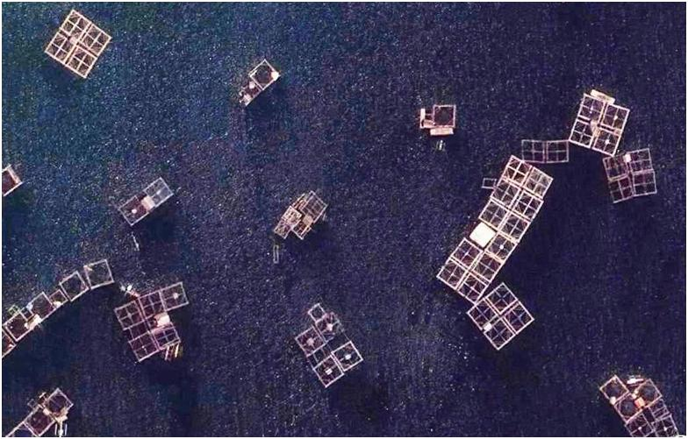
THANK YOU

